Slide 1
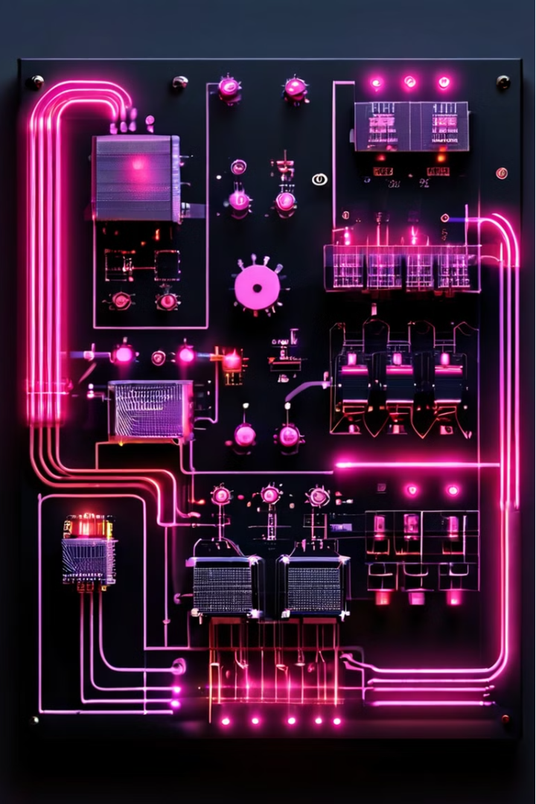

Full-wave Rectifier
A full-wave rectifier is an electrical device that converts alternating current (AC) to direct current (DC), a process known as rectification. This type of rectifier is more efficient than a half-wave rectifier, as it utilizes both the positive and negative half-cycles of the input waveform to produce a DC output.

Slide 2
Key Components
Capacitor
Voltage Supply
Resistors
A capacitor is used to smooth out the ripple in the DC output, providing a more stable and consistent voltage.
The voltage supply provides the alternating current (AC) input that the rectifier converts to direct current (DC).
Resistors are used to control the current flow and ensure the proper operation of the rectifier circuit.

Slide 3
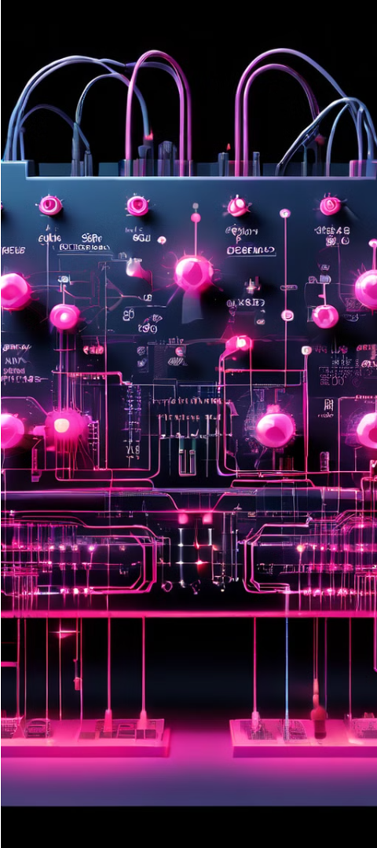
Working Principle
1
Positive Half-Cycle
During the positive half-cycle, diodes D1 and D2 are forward-biased and conduct the current, while the other diodes are reverse-biased and do not conduct.
2
Negative Half-Cycle
During the negative half-cycle, diodes D3 and D4 are forward-biased and conduct the current, while the other diodes are reverse-biased and do not conduct.
3
Full-Wave Rectification
By utilizing both the positive and negative half-cycles, a full-wave rectifier is able to convert the entire input waveform to a DC output, making it more efficient than a half-wave rectifier.

Slide 4

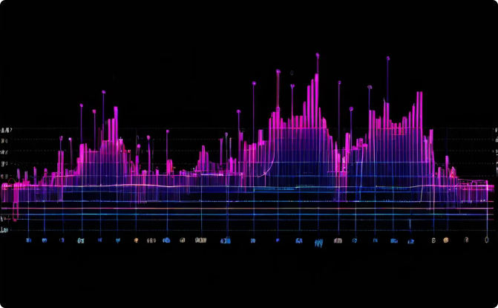
Resistive Load
Input Waveform
Output Waveform
The input to the full-wave rectifier is a sinusoidal waveform, representing the alternating current (AC) supply.
The output waveform of the full-wave rectifier with a resistive load shows both the positive and negative half-cycles, with the voltage not equal to zero during either half-cycle.

Slide 5
RC Load
1
Capacitor Smoothing
2
Ripple Reduction
3
Improved Efficiency
Adding a capacitor in parallel with the load in a full-wave rectifier circuit is crucial for obtaining a stable and reliable DC voltage output, which is essential for powering many electronic devices.
As the capacitor value is increased, the ripple in the output waveform decreases, resulting in a more consistent DC voltage level for the load.
The combination of a full-wave rectifier and a capacitor-smoothed load provides a more efficient and reliable power supply solution for a wide range of electronic applications.

Slide 6
Applications
Power Supplies
Battery Chargers
Full-wave rectifiers are commonly used in power supply circuits to convert AC to DC, providing a stable and reliable power source for various electronic devices and systems.
Full-wave rectifiers are essential components in battery chargers, converting AC mains power to the DC voltage required for charging batteries.
Motor Control
Welding Equipment
Full-wave rectifiers are used in motor control applications, where the DC output is used to control the speed and direction of electric motors.
Full-wave rectifiers are employed in welding equipment, converting AC power to the DC voltage required for the welding process.

Slide 7




Advantages
Efficiency
Stability
Versatility
Reliability
Full-wave rectifiers are more efficient than half-wave rectifiers, as they utilize both the positive and negative half-cycles of the input waveform.
The addition of a capacitor in the circuit helps to maintain a more consistent DC voltage output, providing a stable power source.
Full-wave rectifiers can be used in a wide range of applications, from power supplies to motor control and welding equipment.
The robust design and stable output of full-wave rectifiers make them a reliable choice for many electronic systems and devices.

Slide 8




Limitations
Cost
Complexity
Larger Size
Full-wave rectifier circuits typically require more components, such as additional diodes, which can increase the overall cost of the system.
The additional components and circuitry required for a full-wave rectifier can also make the design and implementation more complex compared to a half-wave rectifier.
The increased number of components in a full-wave rectifier circuit can result in a larger physical size, which may be a consideration in certain applications with space constraints.

Slide 9
Comparison to Half-Wave Rectifiers
Characteristic
Half-Wave Rectifier
Full-Wave Rectifier
Efficiency
Lower
Higher
Ripple Factor
Higher
Lower
Output Voltage
Lower
Higher
Complexity
Simpler
More Complex

Slide 10
Conclusion
1
Versatile Power Conversion
2
Improved Performance
3
Continued Importance
Full-wave rectifiers are a versatile and efficient solution for converting alternating current (AC) to direct current (DC), making them a crucial component in a wide range of electronic applications.
The addition of a capacitor-smoothed load helps to provide a more stable and consistent DC voltage output, improving the overall performance and reliability of the rectifier circuit.
As electronic systems and devices continue to evolve, the importance of full-wave rectifiers in power conversion and control applications is likely to remain significant in the years to come.

